Slide 1
CS 5402 Introduction to Data Mining
Data Mining Methods - Logistic Regression
v.1.0
Perry B. Koob, koobp@mst.edu

Slide 2
What we are going to learn.
Logistic Regression

Slide 3
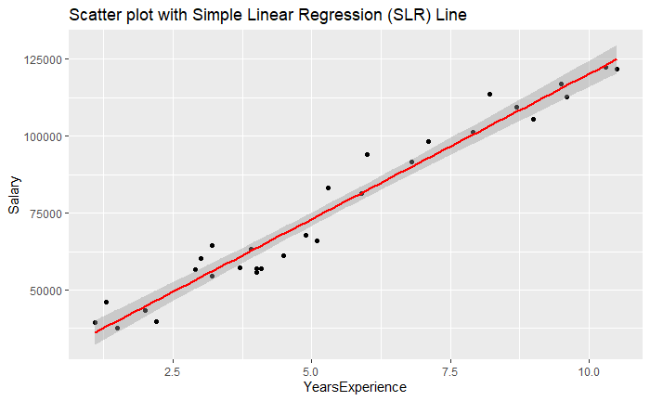
Recalling Regression

Slide 4
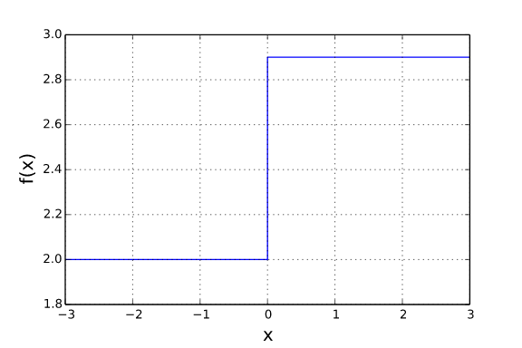
Logistic Regression
Regression can be used for classification, classifying ratio and interval data into a Class.
Ideally we would us something like a step function to classify our data.

Slide 5
Logistic Regression
Membership
Regression can be used for classification, classifying ratio and interval data into a Class.
Ideally we would us something like a step function to classify our data.
Non-Membership

Slide 6
Logistic Regression
Membership
To do that we are not going to be able to use our standard hyperplane function.
We need something different.
Non-Membership

Slide 7
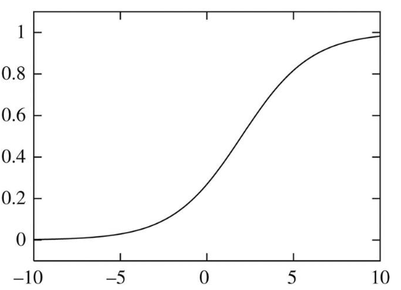
Logistic Regression
We use a sigmoid function instead of a linear function.

Slide 8
Logistic Regression
We use a sigmoid function instead of a linear function.
Class 1
Class 2

Slide 9
Logistic Regression
With logistic regression we are looking binary classifications based on ratio or interval data.
1 if classified 0 if not classified.
1
p(1|a₁,a₂,...,a_{n}) = _________________________
1 + e-(β0 + β1 * a1 + β2 * a2 + … + βn * an)
a₁, a₂, ..., a_{n} = attributes
β₀, β₁, β₂, ..., β_{n} = weights

Slide 10
Logistic Regression
With logistic regression we are looking binary classifications based on ratio or interval data.
1 if classified 0 if not classified.
1
p(1|a₁,a₂,...,a_{n}) = _________________________
1 + e-(w0 + w1 * a1 + w2 * a2 + … + wn * an)
a₁,a₂,...,a_{n} = attributes
₀,w₁,w₂,...,w_{n} = weights
This should look familiar from regression.

Slide 11
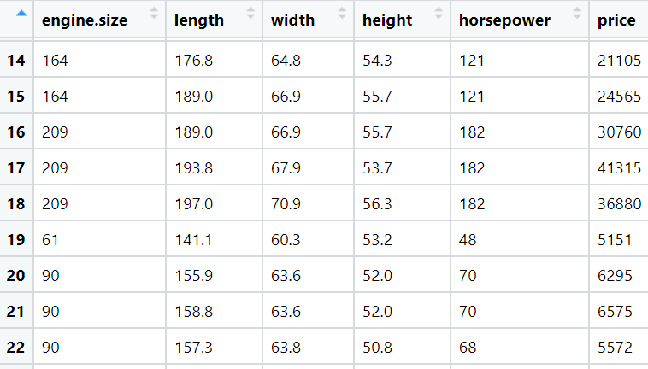
Logistic Regression

Slide 12
Logistic Regression
To use the Logistic Regression we need a binary class.
I will make a Class called Affordable:
If the price of the car is < 10000 I will classify it as affordable.
If it is >= 10000 I will classify it as not affordable.
train$affordable[train$price < 10000] <- 1
train$affordable[train$price >= 10000] <- 0

Slide 13
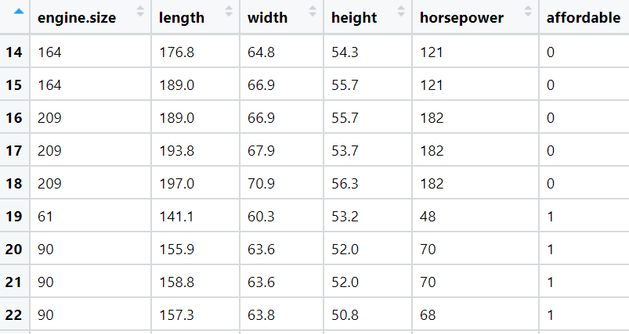
Logistic Regression
To use the Logistic Regression we need a binary class.
I will make a Class called Affordable:
If the price of the car is < 10000 I will classify it as affordable.
If it is >= 10000 I will classify it as not affordable.
train$affordable[train$price < 10000] <- 1
train$affordable[train$price >= 10000] <- 0

Slide 14
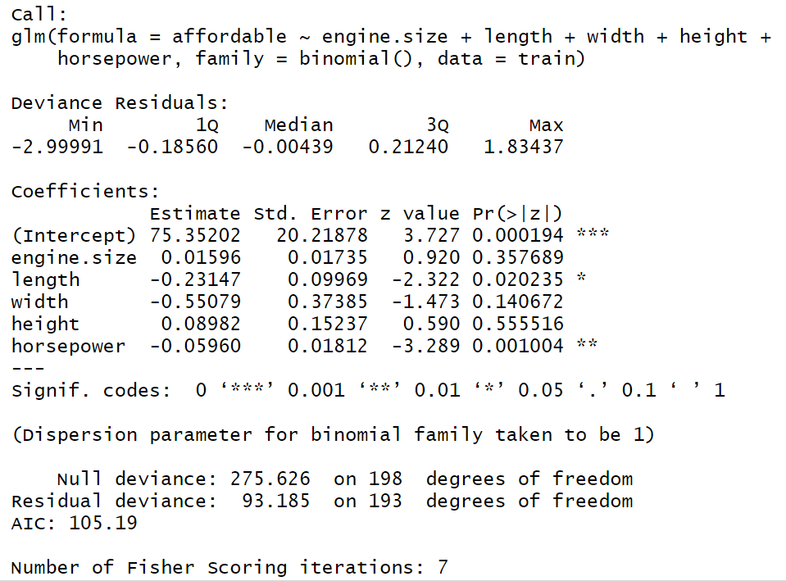
Logistic Regression - R
logit <- glm(affordable~engine.size + length + width + height + horsepower, data=train, family=binomial())
summary(logit)

Slide 15
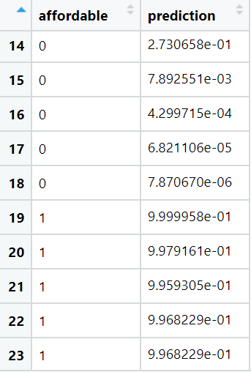
Logistic Regression - R
y <- as.data.frame(train$affordable)
pred <- predict(logit, type="response")
y <-cbind(y,pred)
colnames(y)<-c('affordable','prediction')
Our threshold is 0.5.
If predictor is greater than or equal 0.5 it gets classified as affordable.
If predictor is less than 0.5 is does not get classified as affordable.

Slide 16
Logistic Regression - Python
import pandas as pd
from sklearn.linear_model import LogisticRegression
from sklearn.metrics import confusion_matrix
data = pd.read_csv("..\\src-data\\imports-85-train.csv")
train = data[data['price'] != '?']
train = train[train['horsepower'] != '?']
train['price'] = train['price'].astype(float)
train['affordable'] = 0
train.loc[(train['price'] < 10000), 'affordable'] = 1
x = train[['engine-size','length','width','height']].astype(float)
y = train['affordable']

Slide 17
Logistic Regression - Python
model = LogisticRegression(solver='liblinear',random_state=0)
model.fit(x, y
LogisticRegression(C=1.0, class_weight=None, dual=False, fit_intercept=True,
intercept_scaling=1, l1_ratio=None, max_iter=100,
multi_class='warn', n_jobs=None, penalty='l2',
random_state=0, solver='liblinear', tol=0.0001, verbose=0,
warm_start=False)

Slide 18
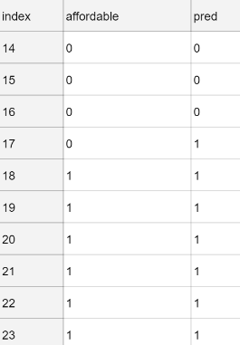
Logistic Regression - Python
pred = pd.DataFrame(model.predict(x), )
pred.rename(columns = {0:"pred"}, inplace = True)
results = pd.concat([y, pred], axis=1)
results

Slide 19
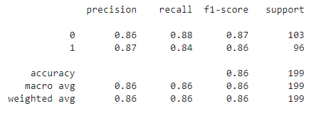
Logistic Regression - Python
confusion_matrix(y, model.predict(x))
array([[91, 12],
[15, 81]], dtype=int64)
from sklearn.metrics import classification_report
print(classification_report(y, model.predict(x)))

Slide 20
What we covered.
Logistic Regression

Slide 21
What to learn more?
For Regression take CS 5204 / STAT 5346

Slide 22
References
Kassambara, Realstack, Visitor, & Mann, T. (2018, March 11). Linear Regression Assumptions and Diagnostics in R: Essentials. Retrieved from http://www.sthda.com/english/articles/39-regression-model-diagnostics/161-linear-regression-assumptions-and-diagnostics-in-r-essentials/
Shmueli, G., Bruce, P. C., Yahav, I., Patel, N. R., & Lichtendahl Jr, K. C. (2017). Data mining for business analytics: concepts, techniques, and applications in R. John Wiley & Sons.
Witten, I. H., Frank, E., Hall, M. A., & Pal, C. J. (2016). Data Mining: Practical Machine Learning Tools and Techniques.

